Slide 1
Computer Programming ICT-1205
Dr. Mohammad Abu Yousuf
yousuf@juniv.edu

Slide 2
THE CLASS DESTRUCTOR
When an object is created, a constructor is called automatically to manage its birth.
Similarly, when an object comes to the end of its life, another special member function is called automatically to manage its death. This function is called a destructor.
Each class has exactly one destructor. If it is not defined explicitly in the class definition, then like the default constructor, the destructor is created automatically.

Slide 3
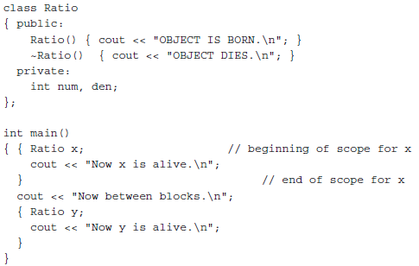
Example of destructor:

Slide 4
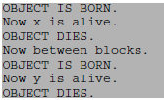
Output of previous program:
The class destructor is called for an object when it reaches the end of its scope.

Slide 5
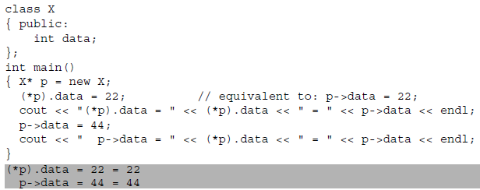
POINTERS TO OBJECTS
Since p is a pointer to an X object, *p is an X object, and (*p).data accesses its public member data.
Note that parentheses are required in the expression (*p).data because the direct member selection operator “.” has higher precedence than the dereferencing operator “*”.

Slide 6
STATIC DATA MEMBERS
We can define class members static using static keyword. When we declare a member of a class as static it means no matter how many objects of the class are created, there is only one copy of the static member.
A static member is shared by all objects of the class. All static data is initialized to zero when the first object is created, if no other initialization is present.
We can't put it in the class definition but it can be initialized outside the class as done in the following example by redeclaring the static variable, using the scope resolution operator :: to identify which class it belongs to.

Slide 7
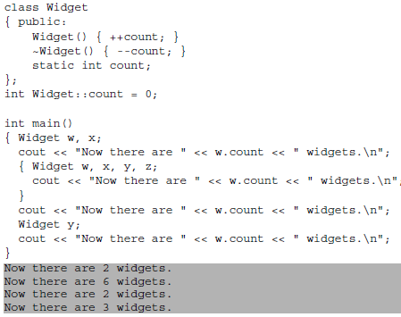
STATIC DATA MEMBERS

Slide 8
STATIC DATA MEMBERS
Notice how four widgets are created inside the inner block, and then they are destroyed when program control leaves that block, reducing the global number of widgets from 6 to 2.

